Slide 1




Freshman & Sophomore Year
What you need
to know
to succeed
Notes:
Today we are going to give you some tips to being successful in school this year and beyond. Your freshman year is a foundation for the rest of high school. What you do this year greatly impacts the rest of your high school career. We are here to help you be successful. If you need assistance, please be sure to ask.

Slide 2
9th and 10th Grade Meeting Agenda
Introductions of guidance staff
Assessments
Success through online grades
Graduation Requirements (academic)
Computing GPA
Attendance

Slide 3
Your Counseling Staff
Ms. Karaki – School Counselor (Non-Music Majors)
Mr. Arrington – School Counselor (Music Majors)
Mrs. Gill – College and Career Counselor
Mrs. Frederick- School Social Worker
Mrs. Millan – Guidance Secretary (keeps us all organized!)
Mrs. Gleason- Data Entry/Attendance
Notes:
Who are we? Each of the guidance staff will introduce themselves. Ms. Roman will cover assessment. Ms. Hart will cover Prep HQ and PIV so you can start now to prepare for college or work. Mr. Arrington will go over credits and GPA calculation.

Slide 4
ASSESSMENT
PSAT
FSA
EOC’s
NWEA
Notes:
Hopefully most of you have completed the FCAT requirement. If not, the FCAT re-take will be held in October. The ACT and SAT are mandatory if you plan to go to college. They also can serve as a substitute for FCAT scores. And you may want to take one of these tests so you are assured of completing the test score requirement for graduation. The CPT is not given to all 11th graders and if you pllan to go to

Slide 5
PSAT/NMSQT
A program cosponsored by the College Board and National Merit Scholarship Corporation.
The first official step on the road to college.
Assesses the skills developed through years of study in a wide range of courses.
Predicts SAT outcome.
Provides insight into student career interests.
Junior scores are used to qualify students as National Merit Scholarship finalists.
Notes:
This test will also be used to determine placement. Any student identified from the scores on this test to take an AP course will be given the opportunity to do so. AP courses are rigorous and are looked upon favorably by colleges. The test measures Critical reading skills,Math problem-solving skills &Writing skills.
The PSAT/NMSQT includes five sections:
Two 25-minute critical reading sections
Two 25-minute math sections
One 30-minute writing skills section
The whole test requires two hours and 10 minutes. The information sheet being distributed tells you more about the test and you will hear more about the test in your english and math classes.

Slide 6
PSAT DATES & FEES
2021 Test Date
Thursday October 28- 9th Grade
Wednesday, October 13- 10th Grade
2021 PSAT/NMSQT Test
Free for Sophomores and Freshmen- The District Pays.
Notes:
The test is free for Freshman and Sophomores and Juniors must pay to take the test. Junior’s have the added incentive because it is the score obtained on the test during the Junior year that may qualify you for the National Merit Scholarship Corporation’s finalist list. So it is important to take the test all three years.

Slide 7

FSA/EOC 2022
Must pass in order to graduate !!!
Algebra 1 – EOC & FSA Reading (10th)
Practice…practice… practice…..
Must Take One Online class as well.
Notes:
Any student who doesn’t achieve a level 3 on reading must be remediated through an intensive reading class. The same is true for math – less than a level 3 and math remediation is mandated. So each year FCAT counts in this way. Passing the FCAT in 10th grade however is a requirement for graduation. Any student earning less than a 300 scaled score on either the reading or math must retake the test until they pass or after earning the required credits to graduate they will earn a certificate of completion which is not a diploma and will not be accepted at most colleges or work. So the advise for success here is practice. You can do that by going to the link on the screen. There are also other ways to practice – completing your homework, paying attention in class, studying your subjects, all of this contributes to passing the FCAT.

Slide 8

GRADUATION REQUIREMENTS
WHAT YOU NEED TO KNOW!
MS. Karaki, School Counselor
Counsels Drama, Dance, Creative Writing, Tech, Visual Arts
Mr. Arrington, School Counselor
Counsels Band, Orchestra and Vocal

Slide 9
SUBJECT AREA REQUIREMENTS
English - 4 CREDITS
MATHEMATICS – 4 CREDITS (Alg. I, Geo)
SCIENCE – 3 CREDITS (Biology, 2 rigorous)
SOCIAL STUDIES – 3 CREDITS
WORLD HISTORY – 1
AMERICAN HISTORY – 1
AMERICAN GOV’T – .5
ECONOMICS - .5

Slide 10
SUBJECT AREA
REQUIREMENTS CONTINUED
PHYSICAL EDUCATION – 1 (Hope)
PRACTICAL/ PERFORMING ARTS – 1
One Online Class Required for Graduation
Pass FSA (Reading Test)
Pass Algebra I End of Course Exam
24 TOTAL CREDITS FOR GRADUATION. Most OCSA students earn 28 credits.

Slide 11
Scholar Designation for Diploma
Pass Algebra 2 (and EOC)
One more math class above Algebra 2
Pass Biology EOC
Pass Chemistry or Physics
Pass Geometry EOC
One more science class above Chemistry
Pass U.S. History EOC
2 Foreign Lang. Classes in the same lang.
One AP or DE class

Slide 12
Career Technical (CTE)
Digital Media- Mr. Olivo
It is possible if you take the class and pass the exam to earn certification and possibly a merit diploma and college credit.
See your counselor for more information
The testing for certification could be cancelled due to sudden quarantine.

Slide 13
Grade Point Average
Weighted GPA
Grade=Quality Pts.
AP & D E Honors
Classes
A = 5.0 4.5
B = 4.0 3.5
C = 3.0 2.5
Unweighted GPA
Grade=Quality Pts.
A = 4.0
B = 3.0
C = 2.0
D = 1.0
F = 0.0
Notes:
13
Grade point average is computed by dividing the attempted credits into the quality points received based on the class grades.

Slide 14
Computing GPA
Example: Credits Earned 6
Band I – A = 4 Quality pts.
Instrumental Tech – A =4 Quality pts.
English I Honors – B = 3.5 Quality pts.
Biology I – A = 4 Quality pts.
Algebra I Honors – B = 3.5 Quality pts.
World History Honors – F =0 Quality pts.
HOPE – C =2 Quality pts.
Add all the quality points – 21 quality pts. Divide by attempted credits – 7. GPA = 3.00
Notes:
14
Look at this example. Why are only 6 credits earned? Why are the quality points different for some A’s and B’s? Remember the weighted quality points for honors? Note that we used 7 credits to get the GPA even though this student earned six because the Failing grade doesn’t earn credits. If you changed the F to even a D the GPA would compute to be 3.28. Besides the difference in GPA you earned an extra credit toward graduation and you don’t have to take the course over again unless you want to increase your grade and GPA by doing so. That is called grade forgiveness and you can do that if you fail or make a D in a course. C’s or better become a permanent part of your transcript. Change the F to a C and the GPA is 3.43. This GPA is getting closer to what colleges want.

Slide 15
Example Computing GPA
Band I – A = 4.0 Quality pts.
Instrumental Tech – A = 4.0 Quality pts.
English I Honors – B = 3.5 Quality pts.
Biology I Honors – A = 4.5 Quality pts.
Algebra I – B = 3.0 Quality pts.
AP World History – B = 4.0 Quality pts.
HOPE – F = 0.0 Quality pts.
Add all the quality points = 23 quality pts. Divide by attempted credits – 7. GPA = 3.28
Credits Earned 6
Notes:
Look at this example. Why are only 6 credits earned? Why are the quality points different for some A’s and B’s? Remember the weighted quality points for honors? Note that we used 7 credits to get the GPA even though this student earned six because the Failing grade doesn’t earn credits. If you changed the F to even a D the GPA would compute to be 3.28. Besides the difference in GPA you earned an extra credit toward graduation and you don’t have to take the course over again unless you want to increase your grade and GPA by doing so. That is called grade forgiveness and you can do that if you fail or make a D in a course. C’s or better become a permanent part of your transcript. Change the F to a C and the GPA is 3.43. This GPA is getting closer to what colleges want.

Slide 16

Attendance
Attendance is critical, even for digital students
95% daily attendance
No credits/no grad
Unexcused absences/make up work
Tardies- Don't be late to school.
Notes:
The pace of high school courses makes it difficult to miss school and stay adequately prepared for tests and projects.
Dr. Grego our superintendent has challenged us to work toward 95% daily attendance at all of our schools.
In high school if you are absent 10 times in any one class you must pass the final exam in order to get credit for the course even if you are passing both 9 week grading periods. This is extremely important. If you fail the final, in order to get credit in this instance you would have to ask for the district attendance committee to assemble and determine your case specifically or credit will be lost.
If you get unexcused absences you cannot make up work, only midterm and final exams can be made up.
Tardies are a problem at high schools. Tardies take up valuable instructional time for all students, not just the tardy student. We need your help to combat tardies by stressing the importance of getting to class on time. Each high school deals with tardies through its individual school policies.
16

Slide 17
New Community Service Guidelines for 9th and 10th
Community Service is not a graduation requirement, it is needed for the Bright Futures Scholarship and looks good for college letters of recommendation.
We can no longer just accept hours after they are performed. Please follow these steps:
Step 1- All community service must be approved before it is done and must match up with a theme. A proposal form must be done and submitted to your counselor. These forms and packets are located in the front office and on the guidance page of our school website.

Slide 18
Community Service Guidelines
Step 2- Once the service is approved and completed, a log sheet must be filled out and signed by whoever was in charge of the activity.
Step 3- A reflection must be completed with your thoughts about completing the service.
Step 4- The log sheet and reflection must be turned in to your counselor.
Many things do not count as community service that used to count before. Please consult your community service packet.

Slide 19

College and Career Planning
Mrs. Gill,
Career & College Counselor
Career Center is in the Media Center
Notes:
Raise your hand if you registered for Prep HQ as an 8th grader? Stand if you completed your four year plan on FACTS.org. Stand and raise your hand if you participated in the career program Choices Planner. I will be working with anyone who doesn’t have a four year plan to help you build one. I will do some classroom guidance as I have time – probably on how to use Prep HQ and PIV to be more successful. The bulk of my work with be with your Juniors and Seniors.

Slide 20
Get Organized
Keep a portfolio to build resume
Work on extracurricular activities and community service hours.
Follow your instructor’s rule for better organization in your classes.
Check your online grade frequently.
Practice for PSAT on Khanacademy.org
READ: REMIND texts, emails, TEAMS.
Check our OCSA website for information
Use Xello, our college and career platform.
Notes:
One of the areas I can be of help is with being more organized in your life so you will be more successful. First you need a portfolio for all the paperwork you receive during your high school career. Awards, letters, report cards, FCAT scores, community service hours documentation; credit evaluation forms etc.
Prep HQ is a Web based guidance program for high school students with an electronic organizer. It is the way I will communicate with you and your parents
Prep HQ has an area called my organizer that helps you keep track of your volunteer activities, employment, extra curricular activities such as plays you were part of or band competitions etc. Use that to make resume writing easy.
Finally, it’s important to be organized in your classes. Stay on top of assignment due dates and test dates. Don’t turn in late work – it is often not accepted. Have a routine for studying. Same time and place where there are few distractions. Can someone tell me what I mean by that? Keep up with your grades – use PIV to see what you earned on assignments and what assignments you haven’t turned in. Raise your hand if you have ever accessed PIV. I can work with students to show you how to access PIV.

Slide 21
Bright Futures Update
FAS – Academic Scholars
Credits: - 16
GPA – 3.5 BF weighted
Community Service –
100 hours
Test Scores: SAT- 1330 Cr. Reading and Math
Or ACT 29
2 years of same foreign language
FMS – Medallion Scholars
Credits: 16
GPA – 3.0 BF weighted
Community Service –
75 hours
Test Scores: SAT:1210
Cr. Reading and Math
Or ACT 25
2 years of same foreign language

Slide 22
Why Go to College?
Expected lifetime earnings
Professional degree | $4.4 million
Doctoral degree | $3.4 million
Master's degree | $2.5 million
Bachelor's degree | $2.1 million
Associate's degree | $1.6 million
Some college | $1.5 million
High school graduate | $1.2 million
Non-high school graduate | $1 million
Source: U.S. Census Bureau
Every bit of education you get after high school increases the chances you'll earn good pay.
The more education you get the more likely it is you will always have a job.
Continuing education after high school is much more important for your generation than it was for your parents' generation.
Education beyond high school gives you a lot of other benefits

Slide 23


Slide 24
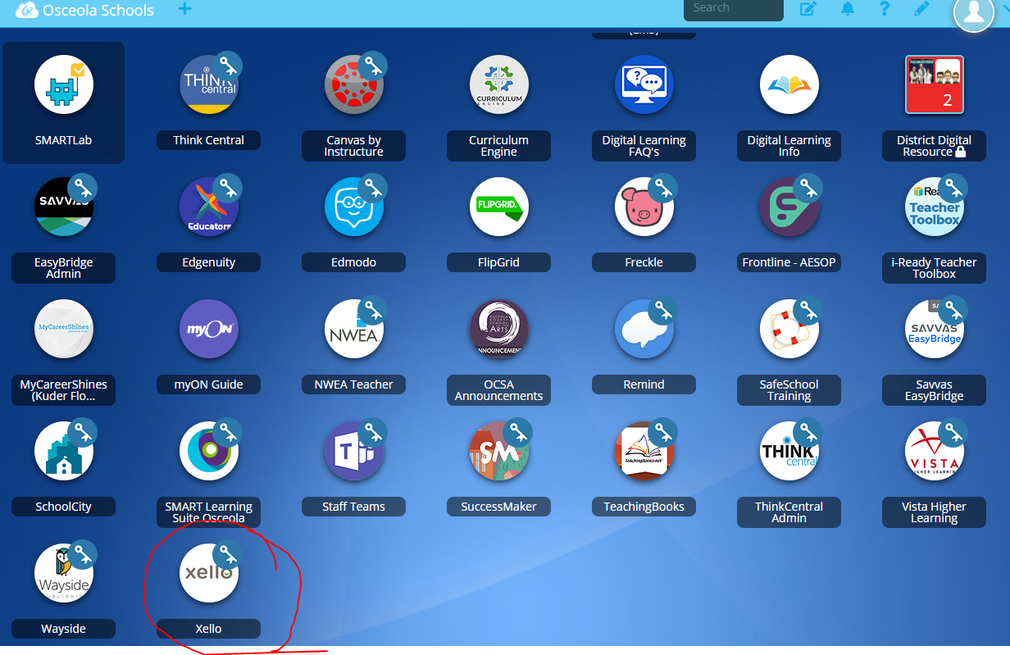
XELLO

Slide 25
Xello Reminder
Use Xello on a regular basis for lesson completion
1
You can go into Xello through your Classlink
2
Please also check for assignments from Mrs. Gill
3

Slide 26
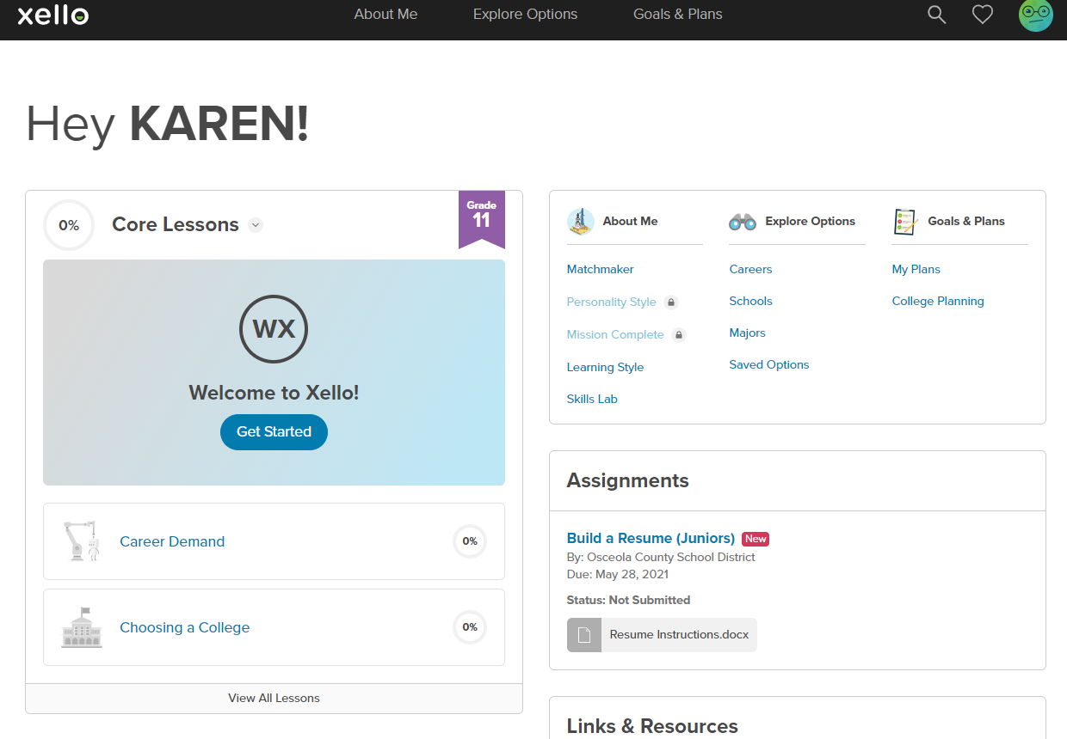
Xello

Slide 27
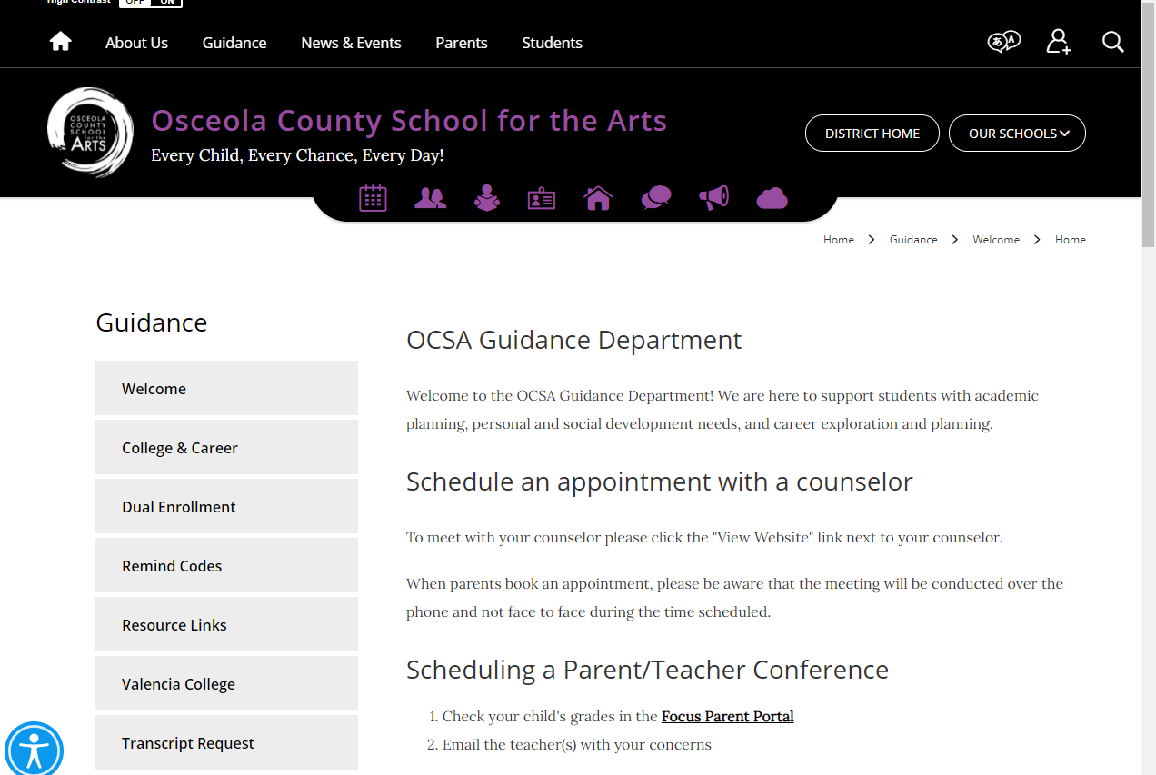
Our Webpage

Slide 28

Password RESET!

Slide 29
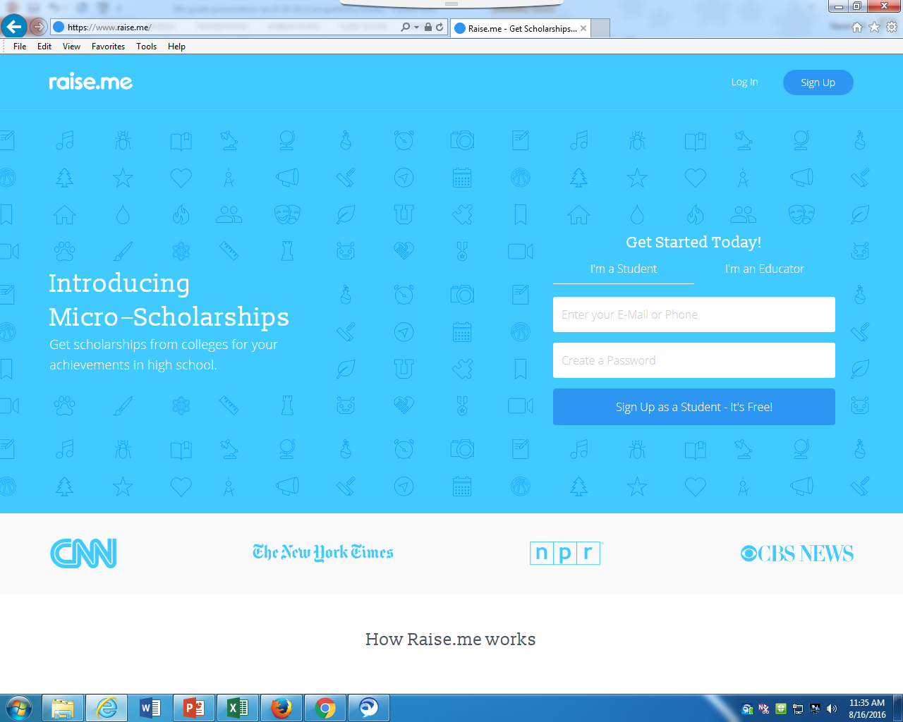

Slide 30

Join code for Remind
For Class of 2024 (10th grade): @69bd72
For Class of 2025 (9th grade): @2abk44
T

Slide 31
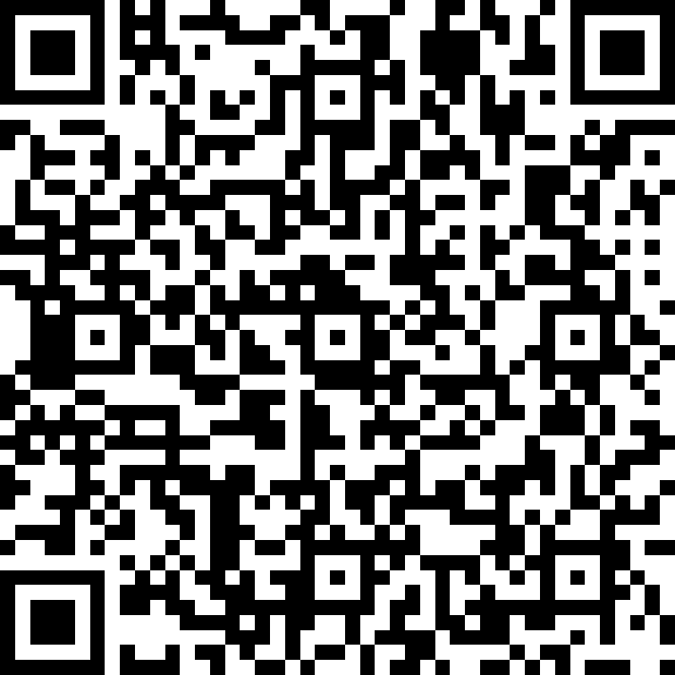
Beginning of the Year Check-In
The counseling team would love to get to know you! This information will help us when we meet with you individually.
Your information will only be shared with the following people: Mr. Arrington, Ms. Karaki, Ms. Gill, and Ms. Fredrick.
Exception: Safety issues

Slide 32
Question & Answer
We will be available to answer any questions.
Have A Successful Year!

